Slide 1


© 2016 IHS Markit. All Rights Reserved.
Cellulosic Ethanol-
Opportunities and Challenges
AIDA Technical Seminar, New Delhi
February 7th, 2019
Jonny Goyal
Principal Research Analyst | IHS Markit
Process Economics Program
OMDC (Oil Midstream Downstream and Chemical)

Slide 2
2
Agenda
Introduction
Biofuels, approaches to fuel & chemicals
Lignocellulosic biomass and cellulosic ethanol
Cellulosic ethanol biochemical conversion process
Opportunities
GHG, India Ethanol Scenario, Fuel Blending Program
Worldwide cellulosic ethanol plant status
Challenges
Some sad stories, issues impacting the commercialization
Evaluation at IHSM end
Demo
Conclusions

Slide 3
Different Generations of Biofuels
3
First generation: derived from sources like starch, sugar, animal fats and vegetable oil (food-crops). E.g. Biodiesel, Vegetable Oil, Biogas, Bio-alcohols,
Second generation: mainly feedstock is non-food crops/ waste crops (after they have fulfilled the food purpose), lignocellulosic biomass, residue
Third generation biofuels: improvements in the production of biomass. Engineered energy crops such as Algae.

Slide 4
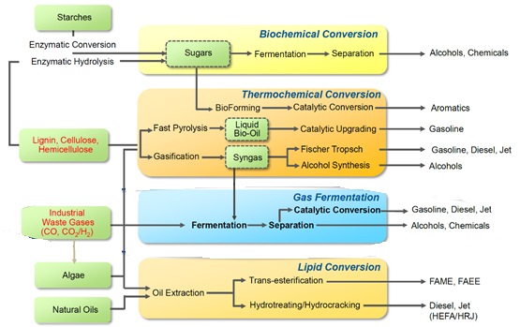
2
Novel Approaches to Fuel & Chemicals
Source: LanzaTech

Slide 5
Lignocellulosic Biomass and Cellulosic Ethanol
3
Lignocellulose is the structural material of biomass
Consist of
Cellulose (C6 sugar polymers)
Hemicellulose (C5 sugar polymers)
Lignin (aromatic alcohol-polymers)
Main feedstocks includes agricultural residue (straw, corn stover) and wood residue (wood chips), lignocellulosic energy crops like switchgrass, reeds etc.
Feedstock is given pretreatment
Cellulose and hemicellulose are separated from lignin
Saccharification of these polysaccharides (through enzyme hydrolysis)
C6 sugars can be fermented by common yeast, C5 by microorganisms to produce ethanol (called cellulosic ethanol)
Ethanol is distillated as per purity requirements.
Lignin separated is dried and can be used as fuel for power generation

Slide 6
Typical products and by-products of cellulosic ethanol technology
3

Slide 7
Lignocellulosic Biomass Pretreatment
3
Factors contributing to recalcitrance of lignocellulosic biomass to hydrolysis: -
Poor accessible surface area
Protection of cellulose by lignin
The heterogeneous character of biomass particles
Cellulose sheathing
Pretreatment lead to: -
Increasing of the surface area and porosity.
Modification of Lignin structure
Removal of Lignin
(Partial) depolymerization of hemicellulose
Removal of hemicellulose
Reducing the crystallinity of cellulose

Slide 8
Aqueous phase biomass hydrolysis
3
Three routes to achieve fermentable sugars (C5/C6):
Pretreated biomass is subjected to enzymatic hydrolysis
Pretreated biomass is subjected to cocktail of enzymes that can affect hydrolysis and fermentation in one pot.
Direct acid hydrolysis of untreated biomass, and then neutralization.

Slide 9
Fermentation
3

Slide 10
Ethanol Distillation
3

Slide 11
Opportunities
3

Slide 12
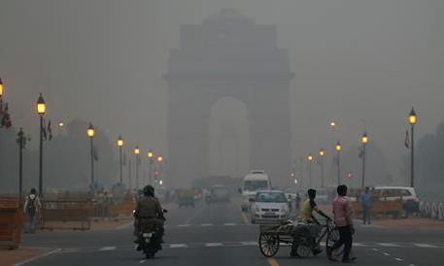
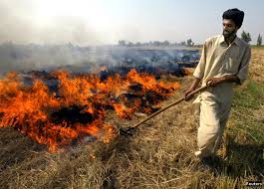
Global Challenge: GHG Emission
3

Slide 13
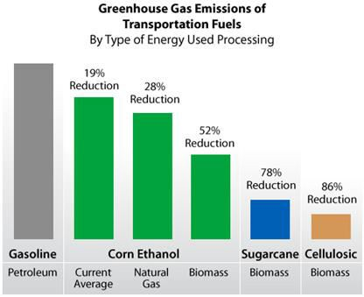
Cellulosic Ethanol Emission Reduction Potential
5
Source: Life cycle Energy and Greenhouse Gas Emissions Impacts of Different Corn Ethanol Plant Types (2007) DOE Bioenergy Technology Office

Slide 14
India Ethanol Scenario
3
Total availability in India = 300 – 320 cr liters approx.

Slide 15
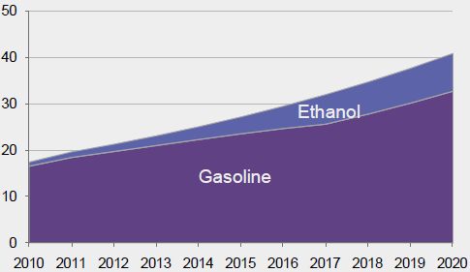
How much Ethanol require for blending?
3
Particulars | 2016-17 | 2017-18 | 2018-19 | 2019-20 | 2020-21 | 2021-22
Petrol Sale (in cr liters) Projection (8.38 % CAGR) | 2759.6 | 34000 | 3241.5 | 3513.1 | 3807.5 | 44000
Ethanol Requirement (in cr liters)
(@ 5% blending) | 138 | 170 | 162 | 175 | 190 | 220
(@ 10% blending) | 276 | 340 | 324 | 351 | 380 | 440
(@ 20% blending) | 551 | 680 | 648 | 702 | 761 | 880
Ethanol gasoline demand under EBP (bln liters)
Source : AIDA conference - 2018
Source: Bloomberg New Energy Finance, Ministry of Petroleum & Natural Gas, Planning Commission, Government of India. Note: Gasoline demand is assumed to grow at 8.5% every year after FY 2011; 1 liter of ethanol assumed to replace 0.7 liters of gasoline.

Slide 16
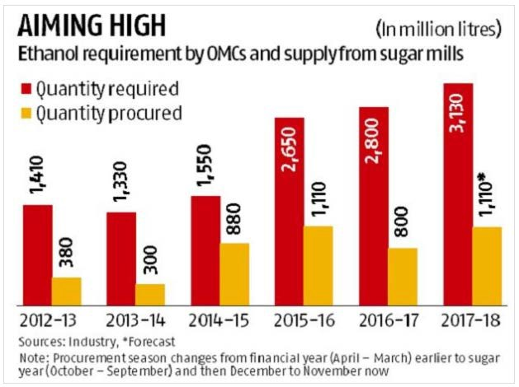
Gap Analysis
3
Source : http://www.business-standard.com/article/economy-policy/govt- raises-ethanol-procurement-price-by-5-for-2017-18-117110101064_1.html
(November – 2017)

Slide 17
5
India State-wise Agricultural Crop Residue (Lignocellulosic Biomass) Potential
State | Agro-residues
 | Biomass Generation (MMT/yr) | Biomass Surplus (MMT/yr)
Punjab | 50.8 | 24.8
Maharashtra | 47.6 | 14.8
UP | 60.3 | 13.8
Haryana | 29 | 11.3
MP | 33.3 | 10.3
Gujarat | 29 | 9.1
Karnataka | 34.2 | 9
Tamilnadu | 22.5 | 8.9
Rajasthan | 29.9 | 8.6
Kerala | 11.6 | 6.4
Bihar | 25.8 | 5.1
West Bengal | 36 | 4.3
AP | 24.9 | 4.3
Odisha | 20.1 | 3.7
Telangana | 19 | 2.7
Assam | 11.4 | 2.4
Chhattisgarh | 11.3 | 2.1
Can produce 3525 crore liters of bioethanol per annum from nearly 141MMT of biomass , which can not only meet nations fuel ethanol requirement , but also export to neighboring countries.
22 million MT of biomass can meet the demand of nation for 20 % ethanol blending.
Straws : 15 million tons of Rice straw is available (90% of it is now burnt in field).
Can produce 300 crore liters of bioethanol per annum which can meet nations demand up to 70 % fuel ethanol
Source : AIDA conference - 2018

Slide 18
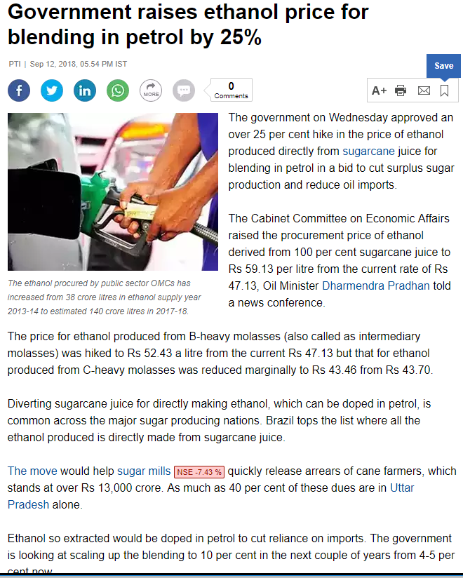
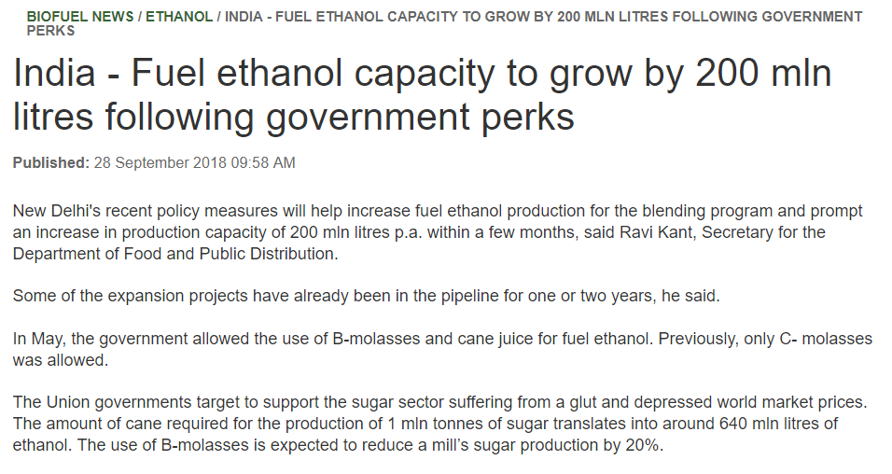
2
Cellulosic Ethanol: Opportunity
National biofuel Policy – 2018
Government of India committed toward implementation of E5/E10 and E20 by 2017 – 2022. Ban on export of fuel ethanol.
Limited molasses availability & demand by industrial/potable sectors poses key challenge in implementing E5/E10 and E20
MoPNG fixed reference price range for fuel ethanol at INR59.0/Liters from INR48.50 – INR49.50/Liter
Government of India removed excise duty on ethanol for blending.
GOI to announce policy for use of E85 & Flex fuel vehicles in India
Paris Climate Change Conference 2015: India commitment to increase target of non-fossil fuel based energy to 40%

Slide 19
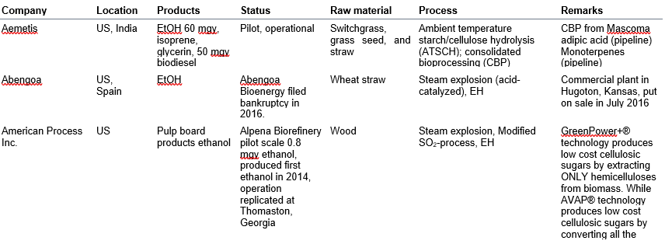
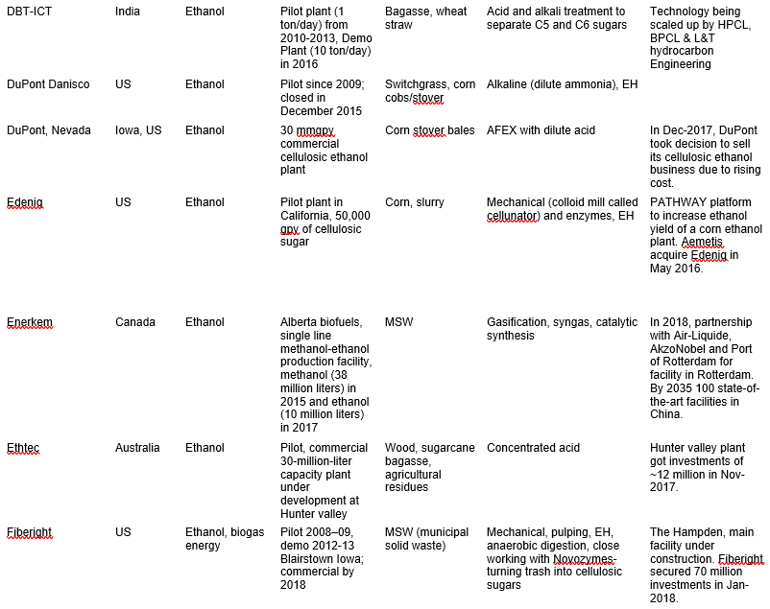
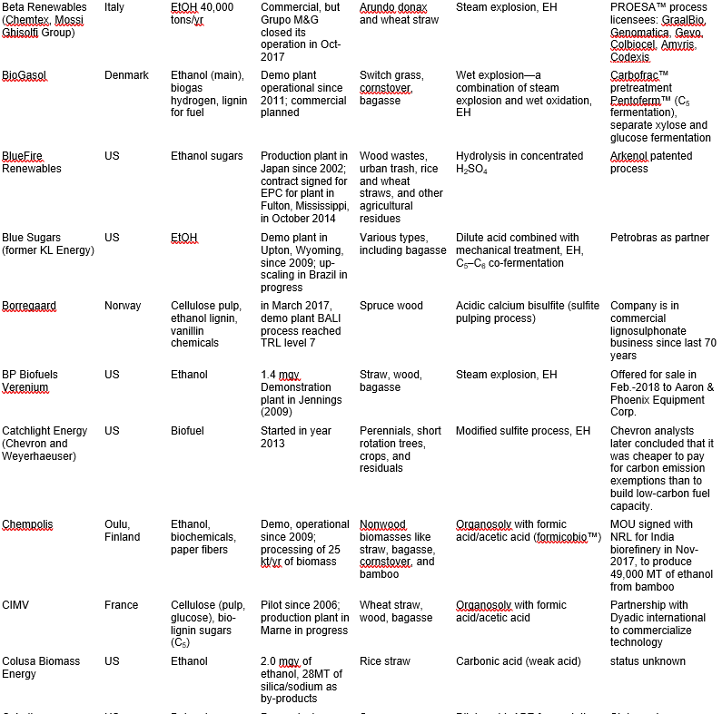
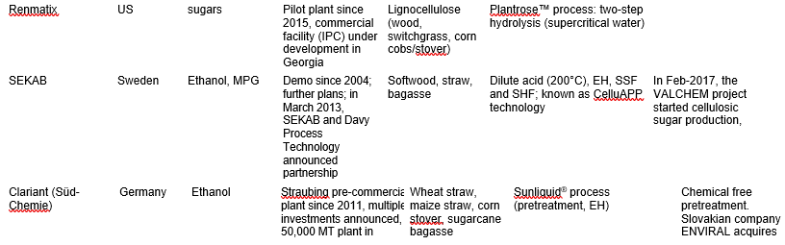
2
Worldwide status
Commercialization by DuPont, Beta-renewable, POET-DSM, GranBio, Iogen etc.
Other players are following the path. Clariant, Praj, Renmatix, Fiberight, Ethtec, Aemetis etc.

Slide 20
Challenges
3

Slide 21
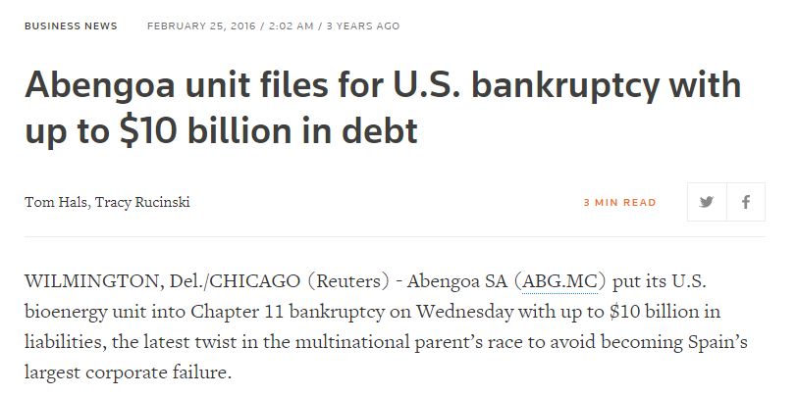
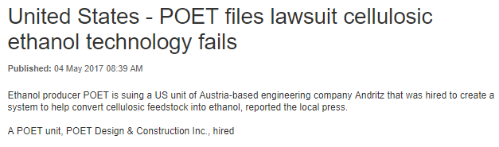
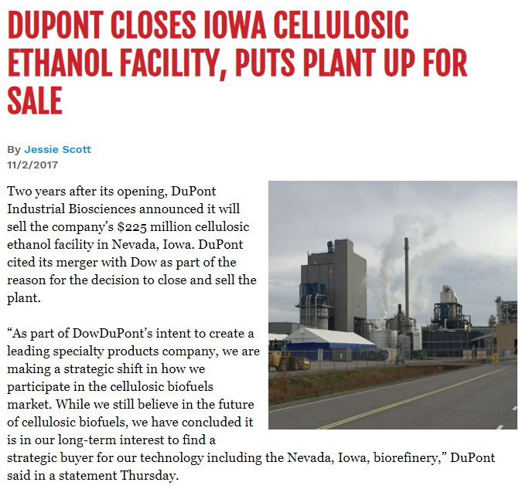
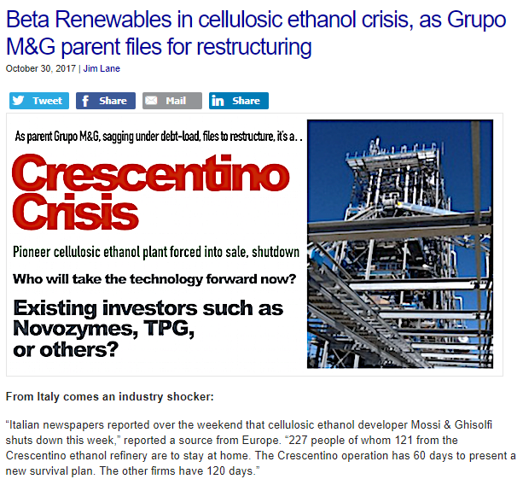
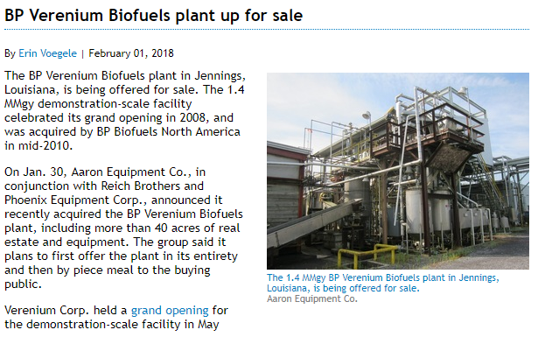
3
Some Sad Stories from World

Slide 22
25
Future challenges of Cellulosic Ethanol technology
Low yield of Lignocellulosic to Bioethanol process
Process Cost
Pretreatment Cost
High Enzyme cost
Uncertain feedstock cost (feedstock delivery and supply chain)
Formation of inhibitors and alcohol concentration
Water requirement
Energy associated with biomass processing
Bioreactor configuration and design (handling living system with no contamination)
Availability and reliability
© 2016 IHS Markit. All Rights Reserved.

Slide 23
25
Issues Impacting the Commercialization of Bioethanol Technologies

Slide 24
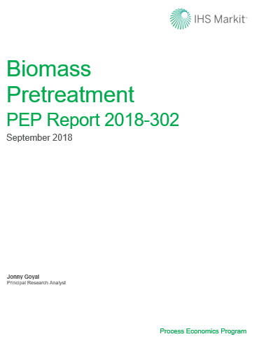
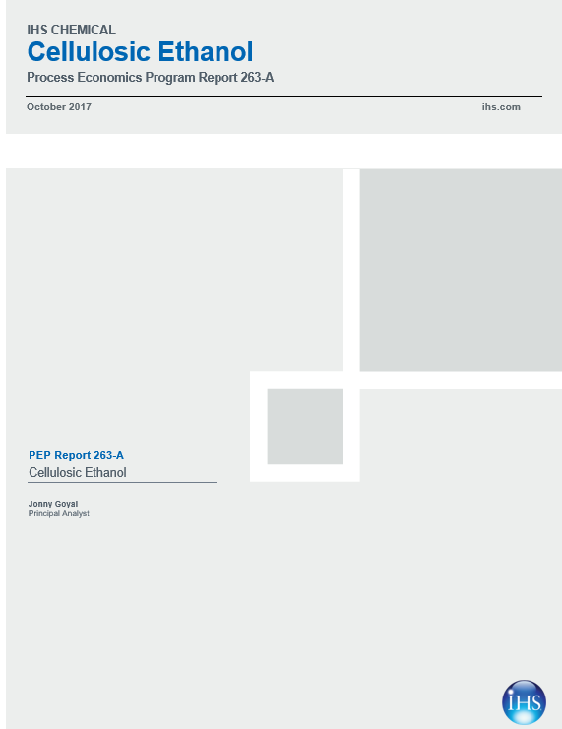
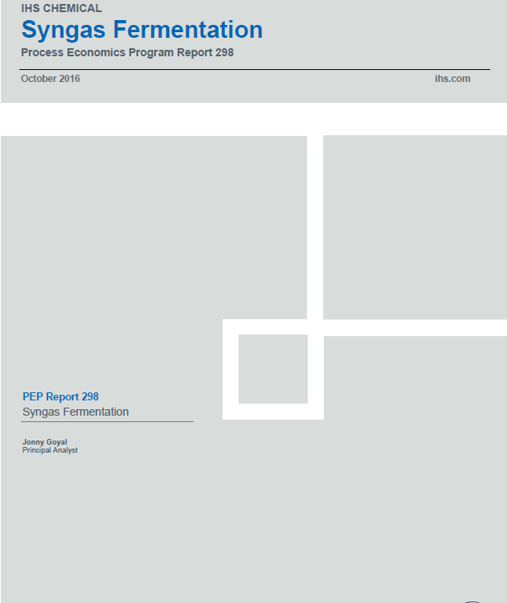
Evaluation at IHSM End for Client Decision Making
3
IHS Markit Process Economic Program (PEP)
Cellulosic Ethanol (Report – 263A)
Evaluation of DuPont cellulosic ethanol plant in Nevada
Beta-renewable commercial cellulosic ethanol plant in Italy
POET-DSM cellulosic ethanol plant in Iowa
Biomass Pretreatment (Report – 302)
Steam explosion + Dilute H2SO4 process
Ammonia Fiber Explosion Process (AFEX)
Organosolv Pretreatment of Lignocellulosic Biomass
Syngas Fermentation (Report – 298)
Ethanol production via syngas fermentation using biomass gasification syngas
Ethanol+2,3-BDO production via syngas fermentation using biomass gasification syngas
Ethanol production via syngas fermentation using steel mill gases

Slide 25
What is in the Basket?
3
Deep patent and literature search/ evaluation
Industry status
Technology review, chemistry, mechanism
Process Flow Diagram
Aspen Plus/ SuperPro simulation software’s
Process Description
Evaluation
Material balance
Equipment specifications
Utility Summary
Total Capital Investments
Capital Investments by Section
Production Cost
Product value
Process Discussions
Process Comparisons
iPEP Navigator file (Ms-Excel easy comparison)

Slide 26
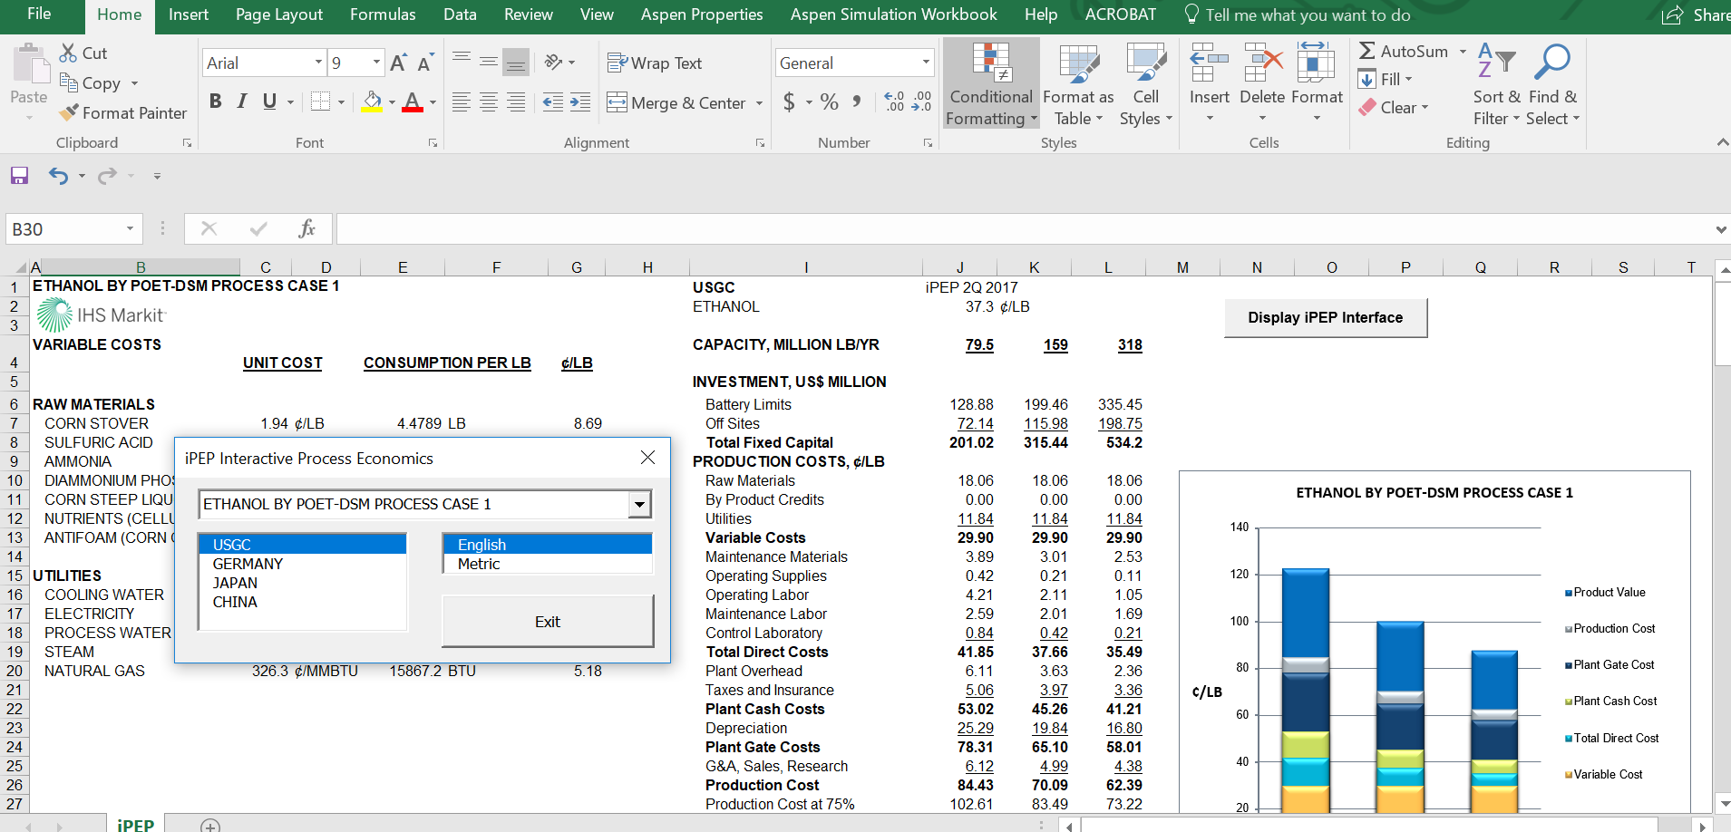
iPEP Navigator Demo (Cellulosic Ethanol Report)
3

Slide 27
Other reports and reviews in our database summary bioethanol reports PEP.xlsx
3

Slide 28
IHSM Conclusions
3
Cellulosic ethanol is feasible technology and answer to sustainable future
Commercialization achieved
Improvement in carbon conversion efficiency is a direct measure of improvement in ethanol yield
Cost of enzyme production will be the key challenge
Struggling with low alcohol concentration in fermenter. R&D efforts needed in this area.
Effective biomass supply chain will reduce cost
Pretreatment shall be handled carefully to reduce inhibitor formation
Different pretreatment technologies need to be investigated with respect to yield, to reduce overall cost

Slide 29
25
Thank you!
Contact: - jonny.goyal@ihsmarkit.com
© 2016 IHS Markit. All Rights Reserved.

